Slide 1
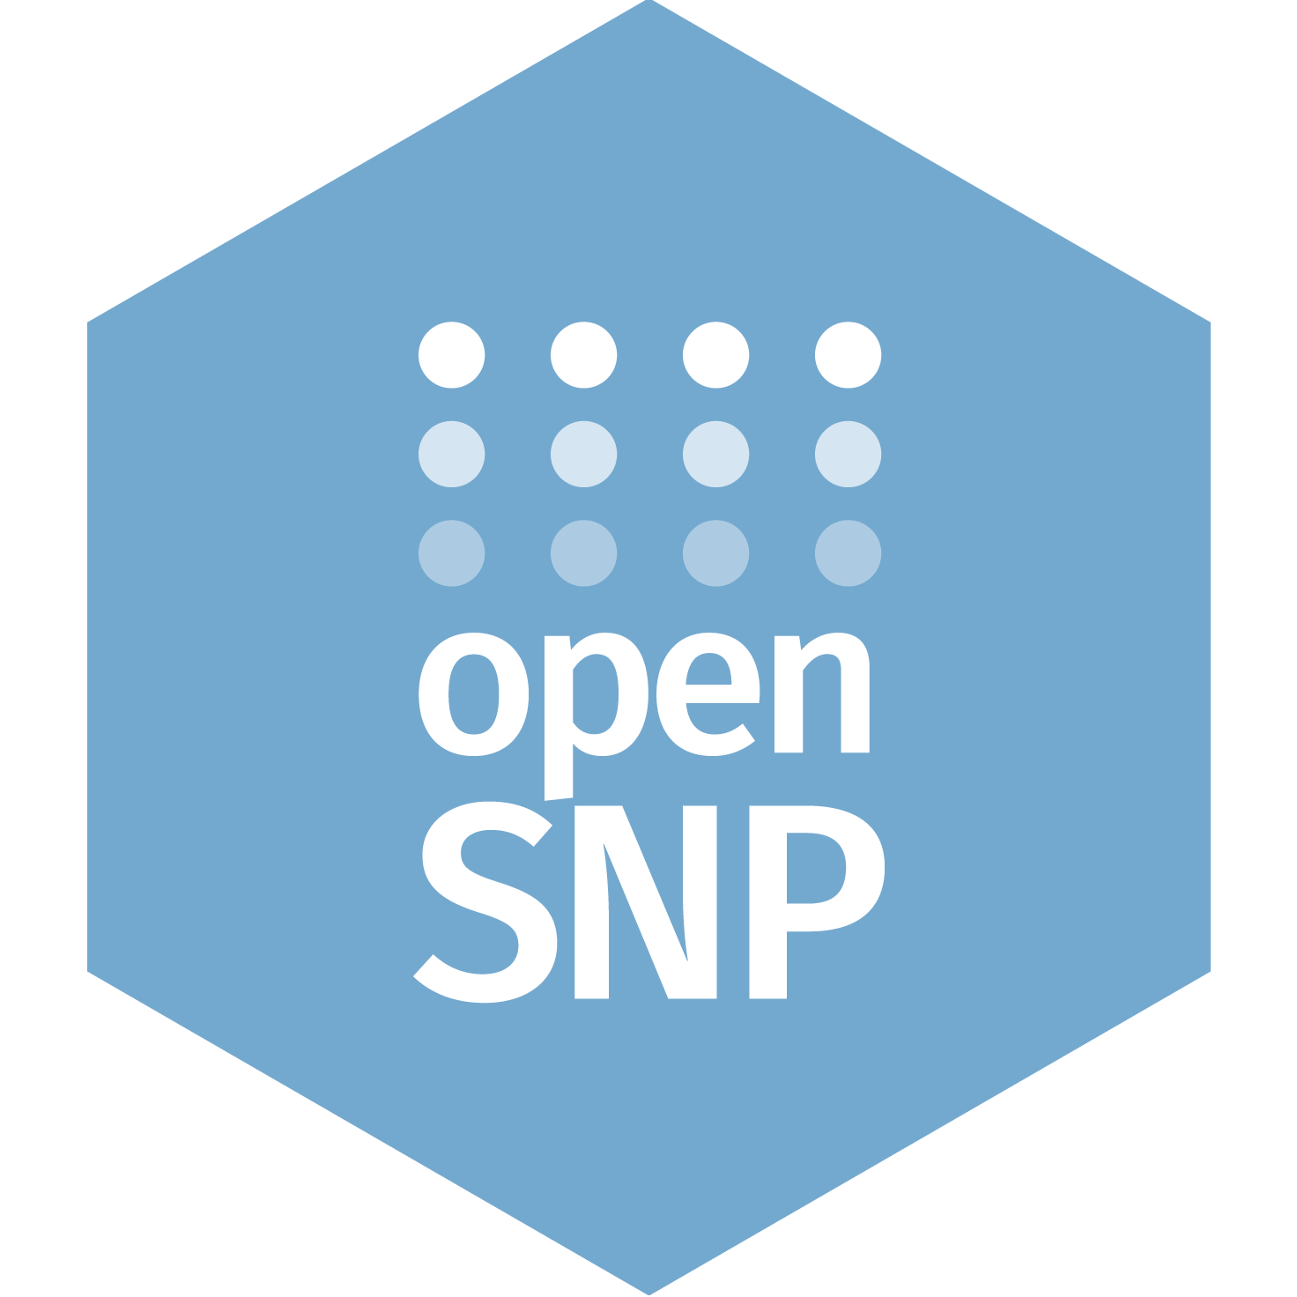

openSNP:
what we learned
6 years of not knowing what we’re doing
Philipp Bayer
@PhilippBayer

Slide 2
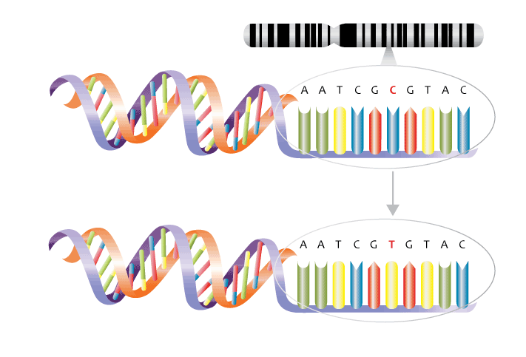
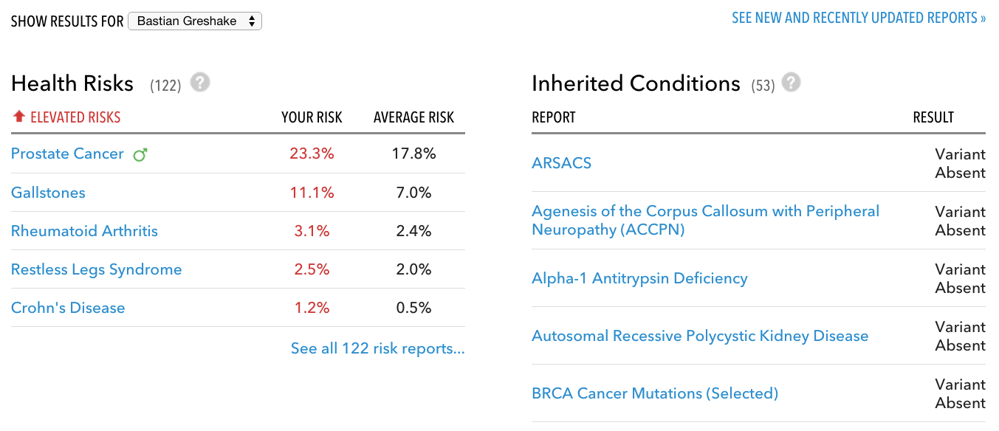
Notes:
What’s a SNP?

Slide 3

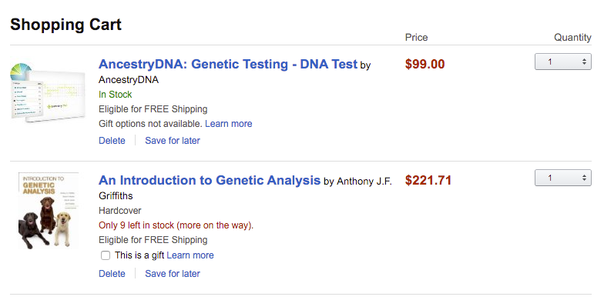

Slide 4
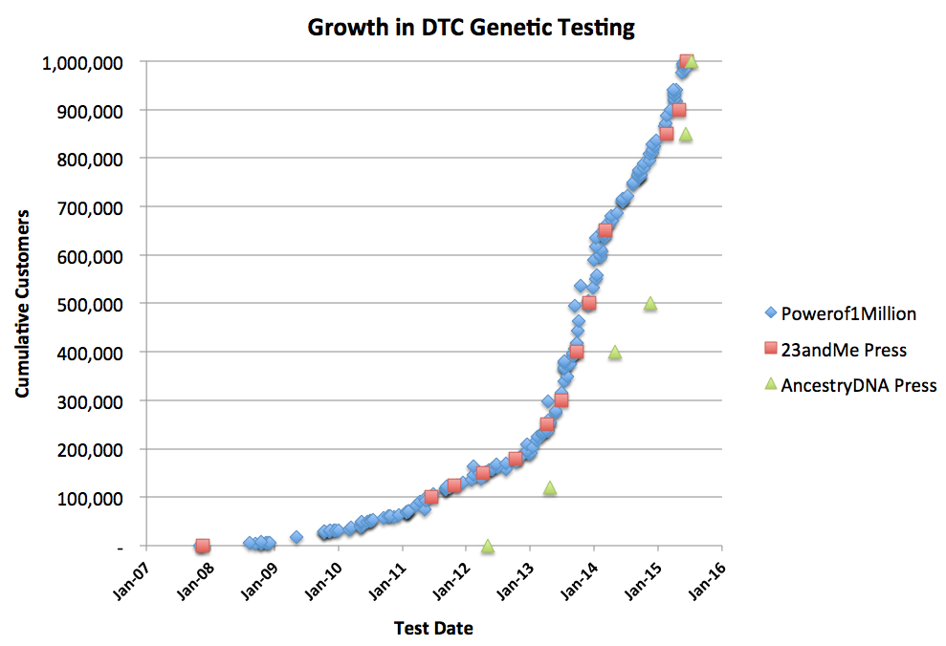
DTC Genetic Testing Numbers

Slide 5

DTC testing & open data

Slide 6
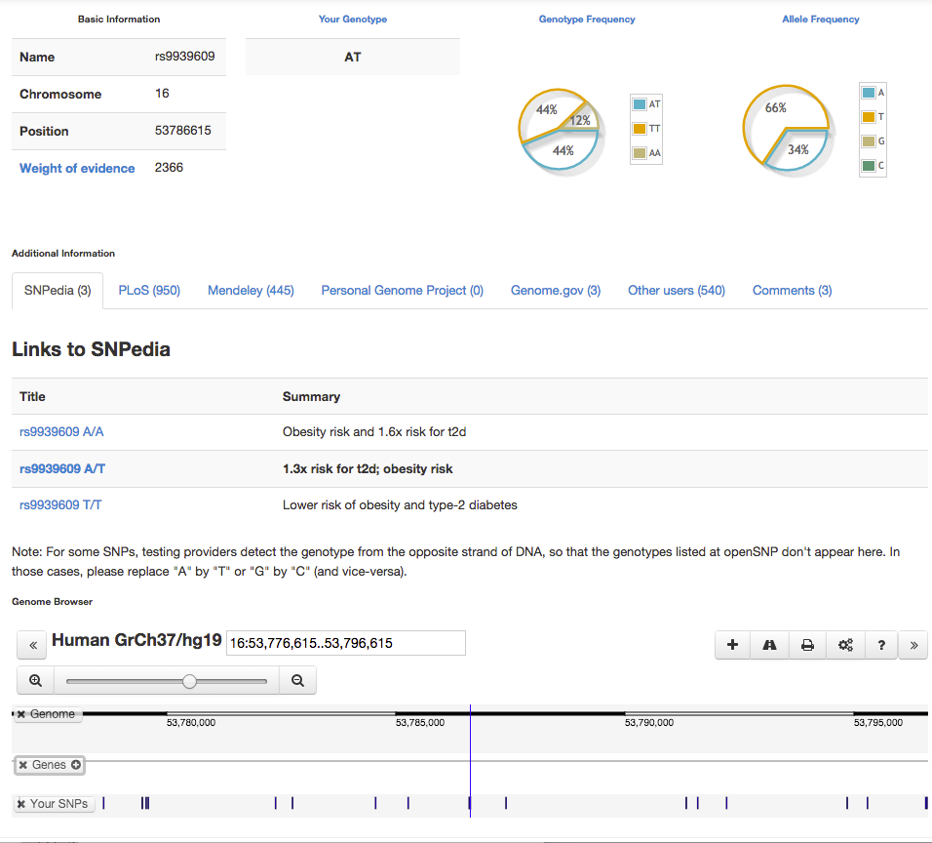
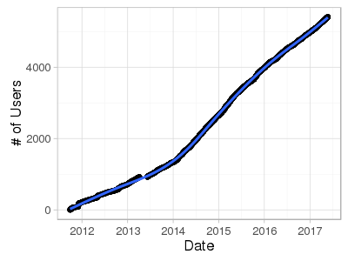
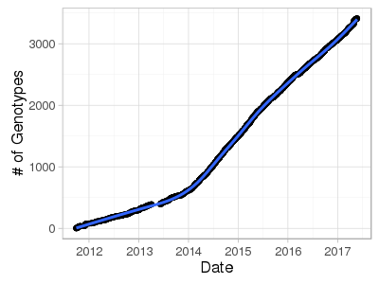
genetic data

Slide 7
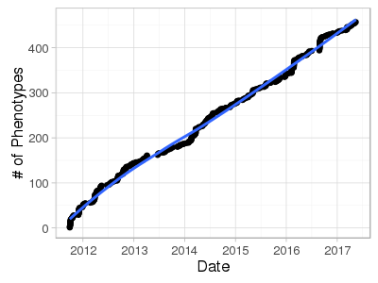
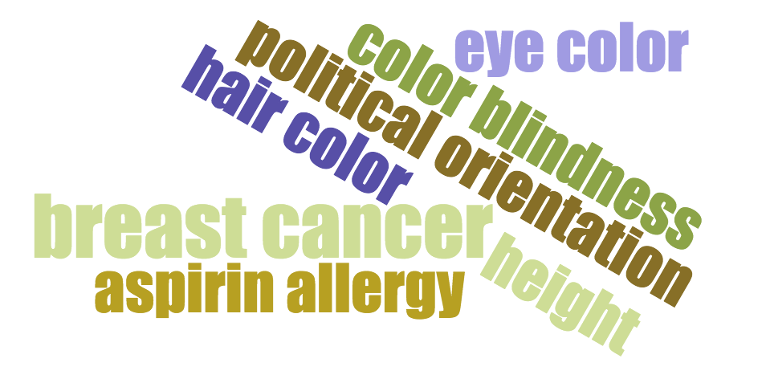
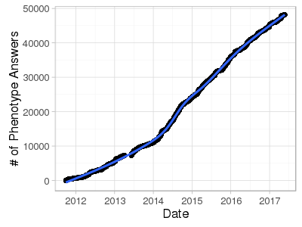
phenotypes
and the most important one:
vim or Emacs?

Slide 8
What we learned

Slide 9
1. People want to help
“
I think maybe 30 people want to upload their data?
- me, 2012, before the other 3,561 people showed up

Slide 10
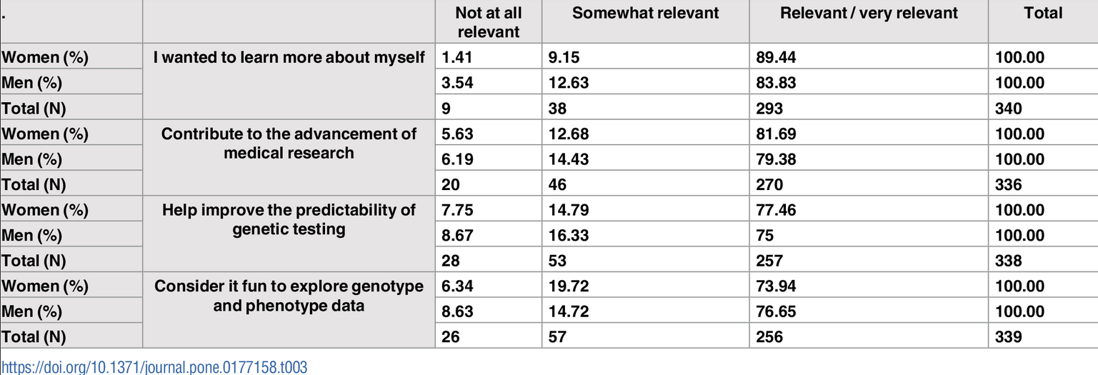
especially if there is
an incentive!

Slide 11
2. There are established
communities willing to help
grow your project

Slide 12

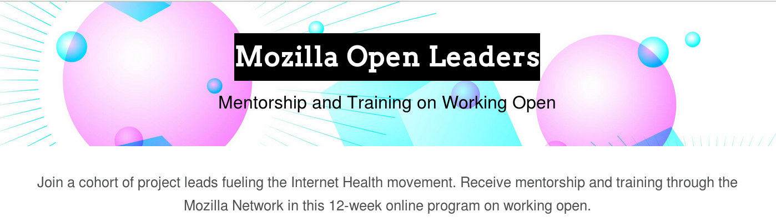
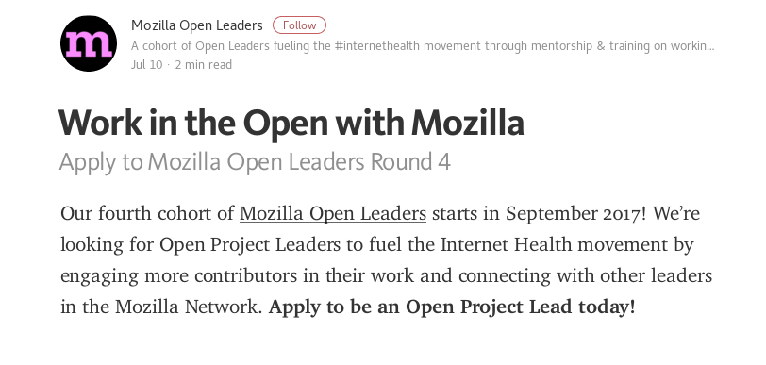
Applications close August 1!

Slide 13
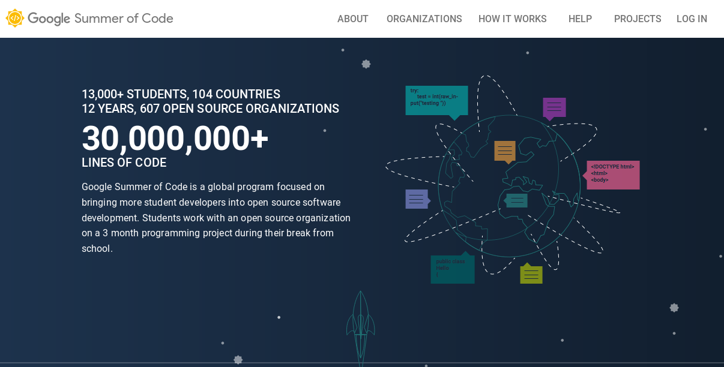

Slide 14
3. Open Source/Data =
You’ll be surprised
how many people
want to help

Slide 15
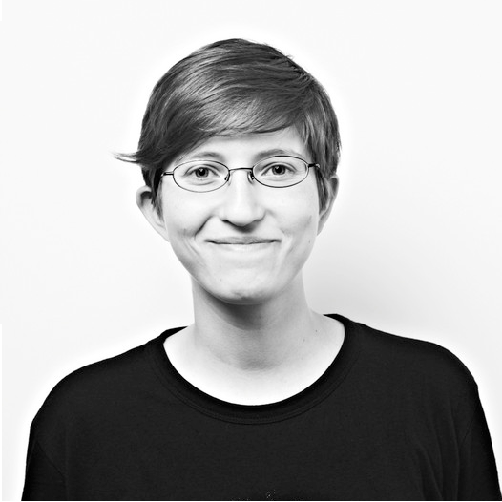
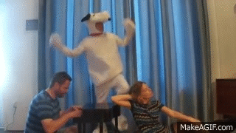
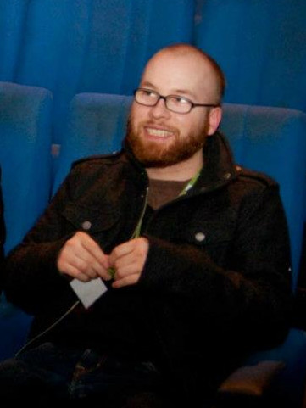
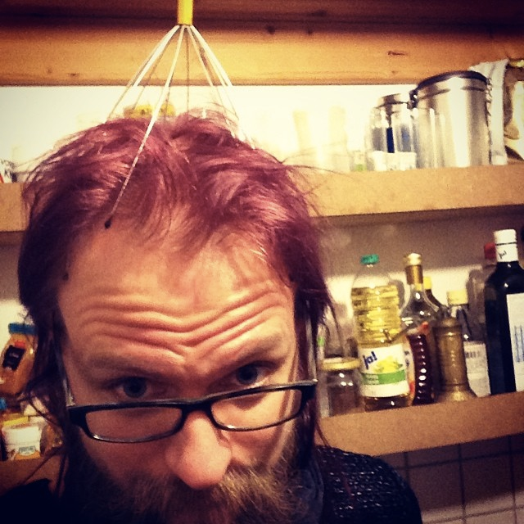
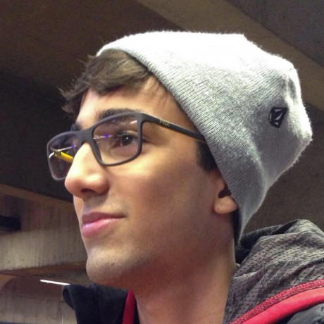
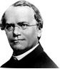
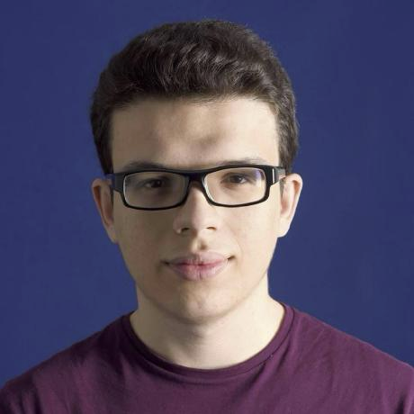
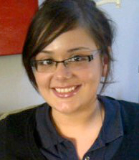
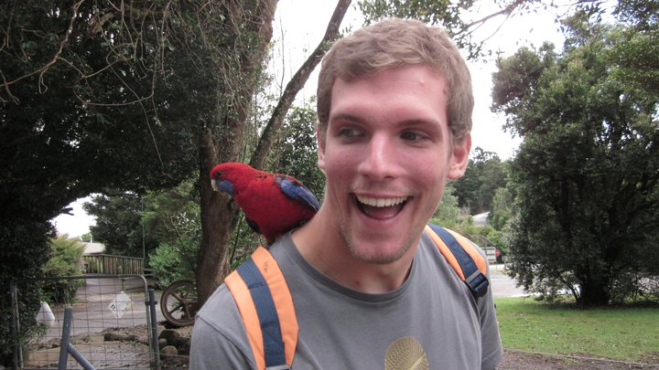
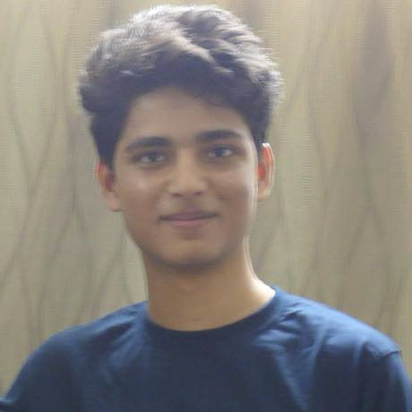
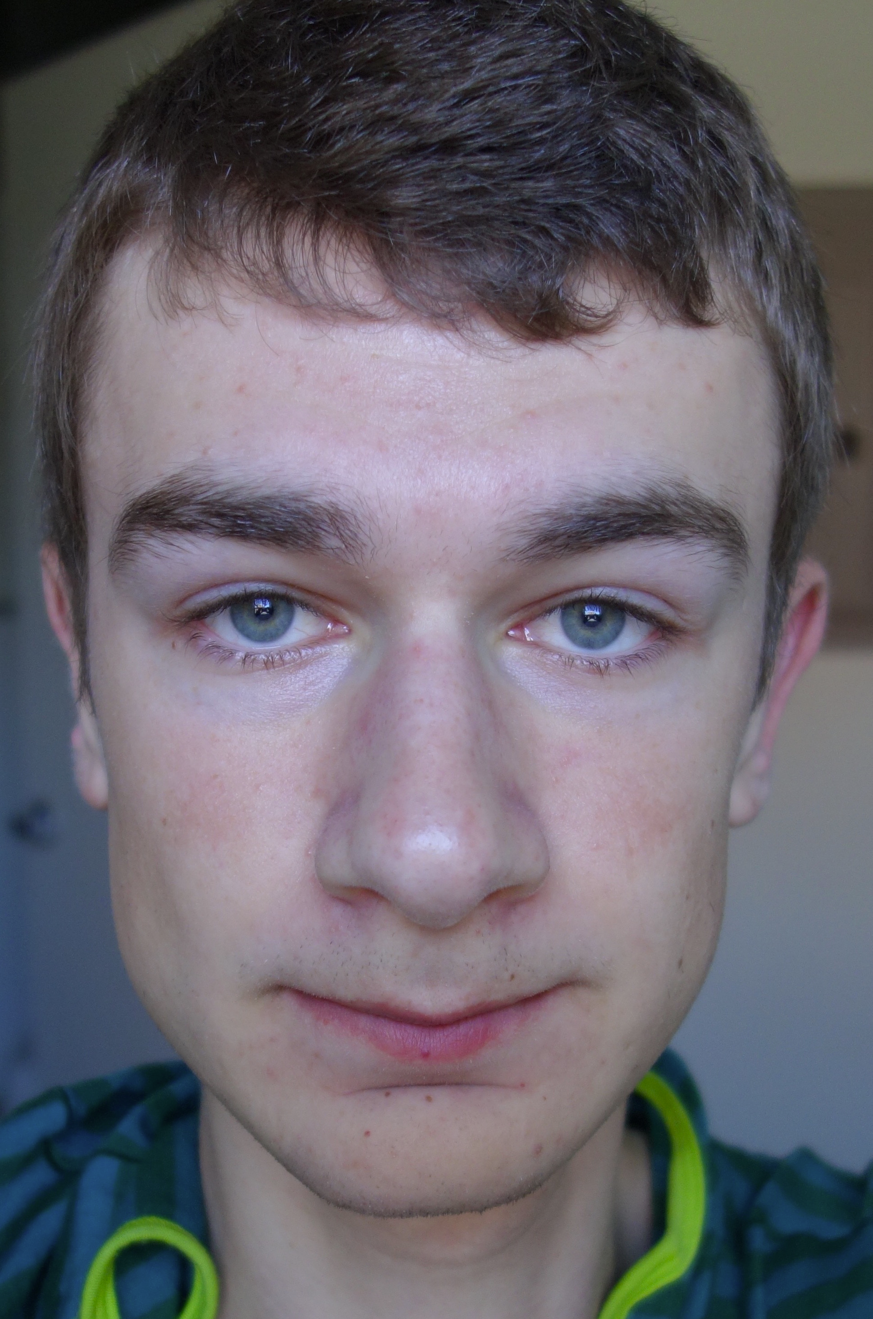

openSNP are:
special thx to:
@wilbanks
@elioqoshi
~5000 users
Our 32 Patreons!
and… https://opensnp.org/humans.txt

Slide 16
4. Your project will be used
in ways you didn’t
think about

Slide 17
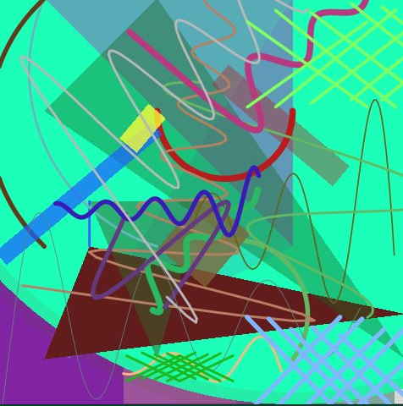
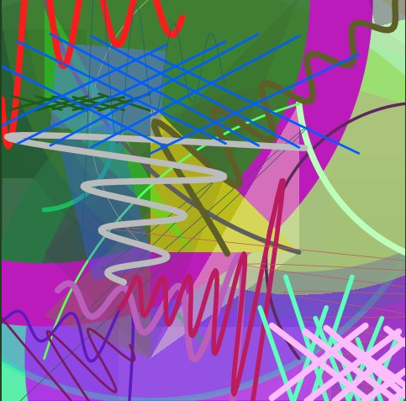
What we thought people will use openSNP’s data for:
- biology
What people are using openSNP’s data for:
- privacy research
- art
- genealogy/ancestry
- teaching
- and biology!

Slide 18
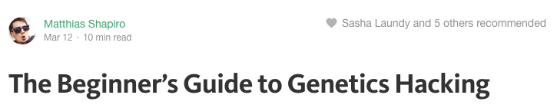
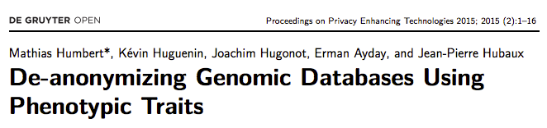
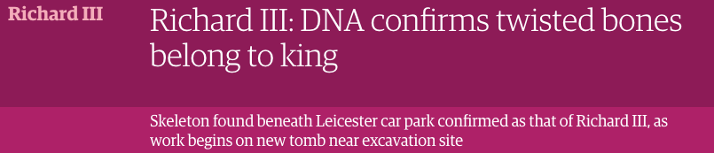
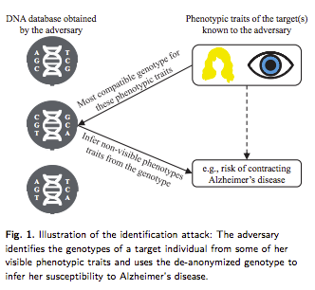
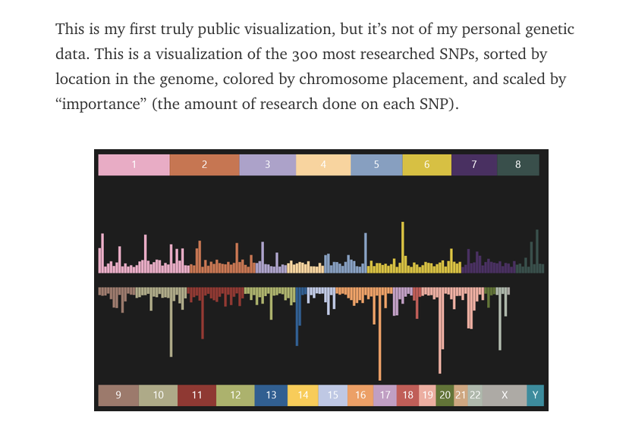
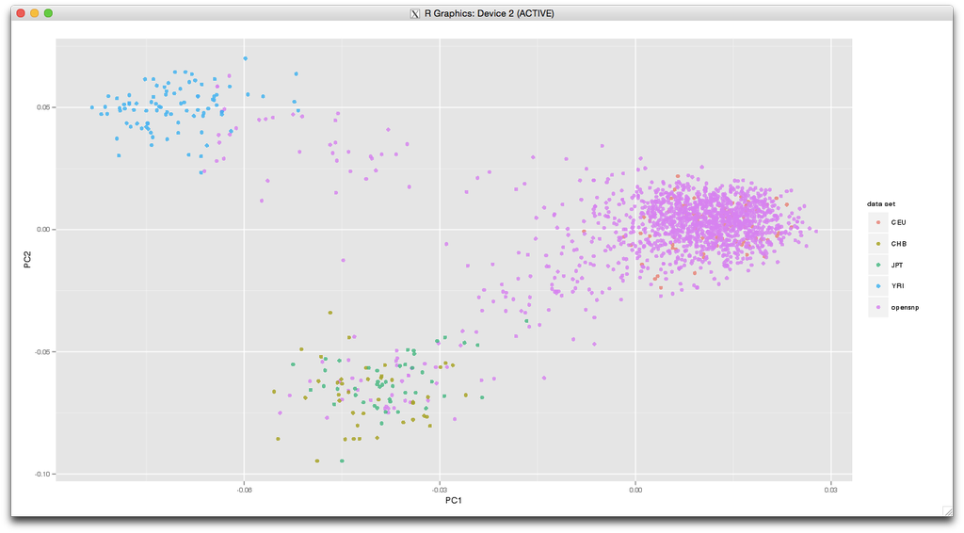
Use Cases
“
[…]
Your results show your European background very well.
[…]
However, you are a 'carrier' for one of the SNPs (rs1805128) in theKCNE1 gene which has been associated with 'torsade de pointes' (but the evidence is very poor!).
[…]
Also, there is no suggestion of consanguinity in your pedigree.

Slide 19
5. Don’t be afraid to ask

Slide 20
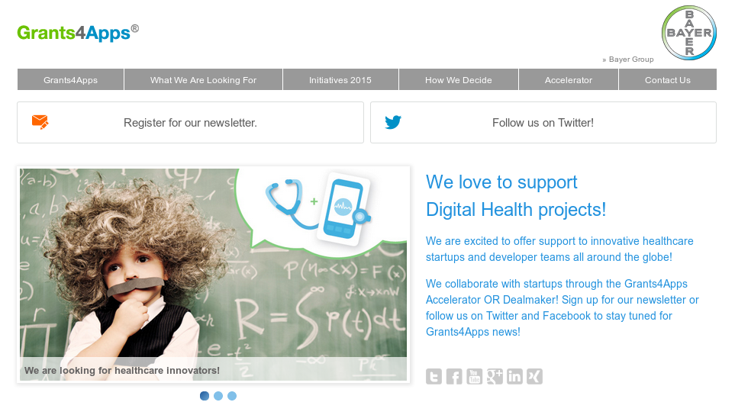



Slide 21
6. Make your project
welcoming

Slide 22
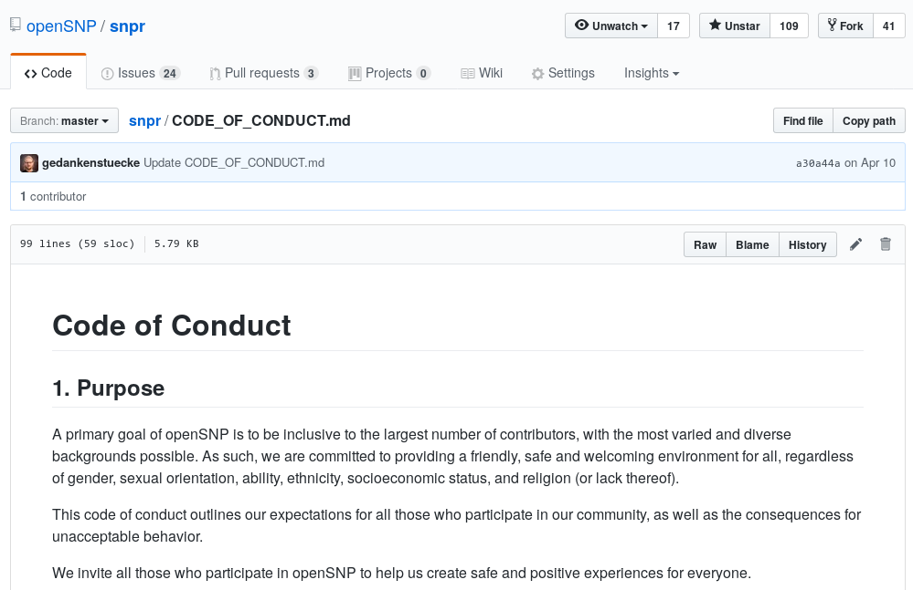
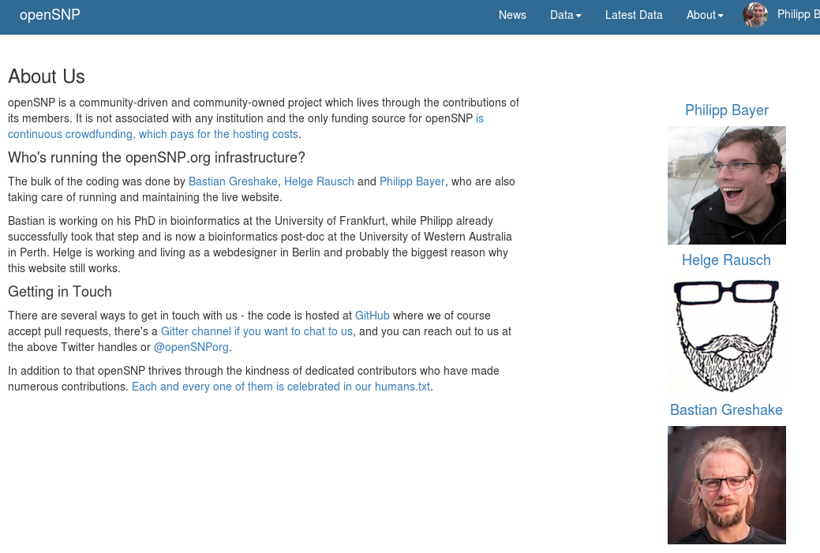
Think about:
Code of conduct
README.md
CONTRIBUTING.md
Contact channels
Project outreach
An ‘About Us’ somewhere
A humans.txt

Slide 23
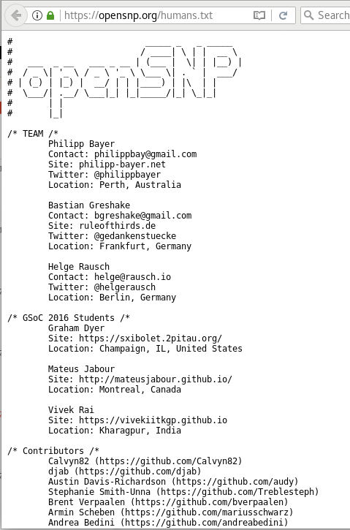
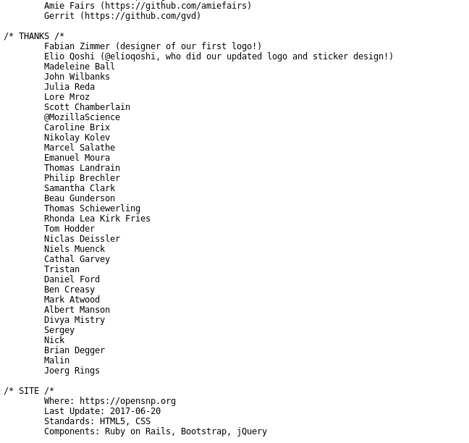

Slide 24
7. All data has
inherent biases,
Including yours

Slide 25

countries

Slide 27
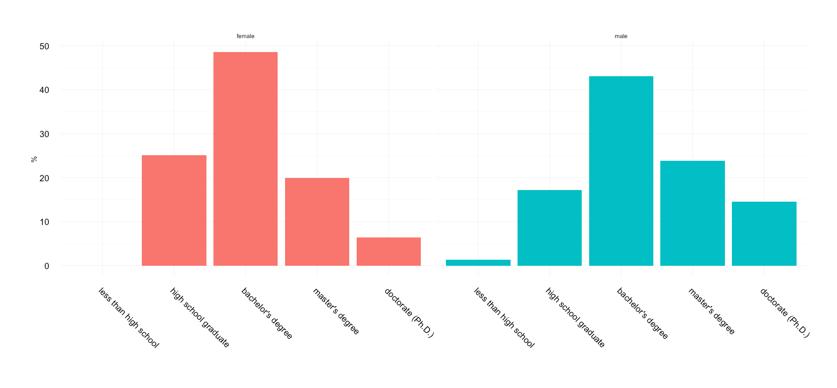
:📚?

Slide 28
8. Unexpected things
will happen

Slide 29
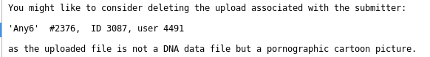
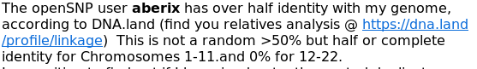
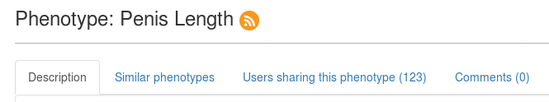

Slide 30
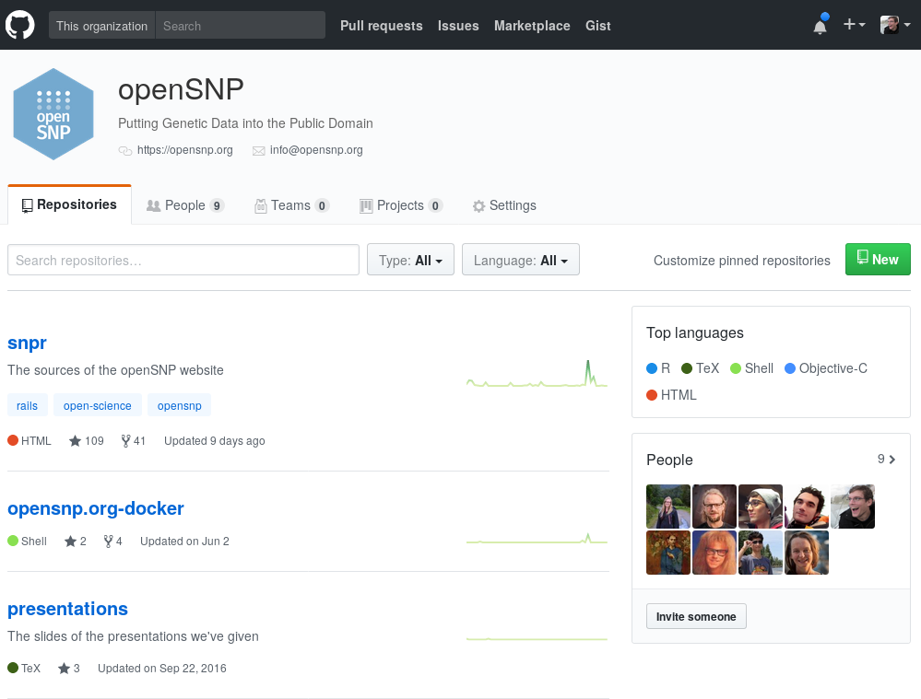
Come along!

Slide 31
And again, thanks to:
@wilbanks
@elioqoshi
~5000 users
Our 32 Patreons!
and… https://opensnp.org/humans.txt

